Slide 1


Fuzzing attack
Ismail Ahmed

Slide 2
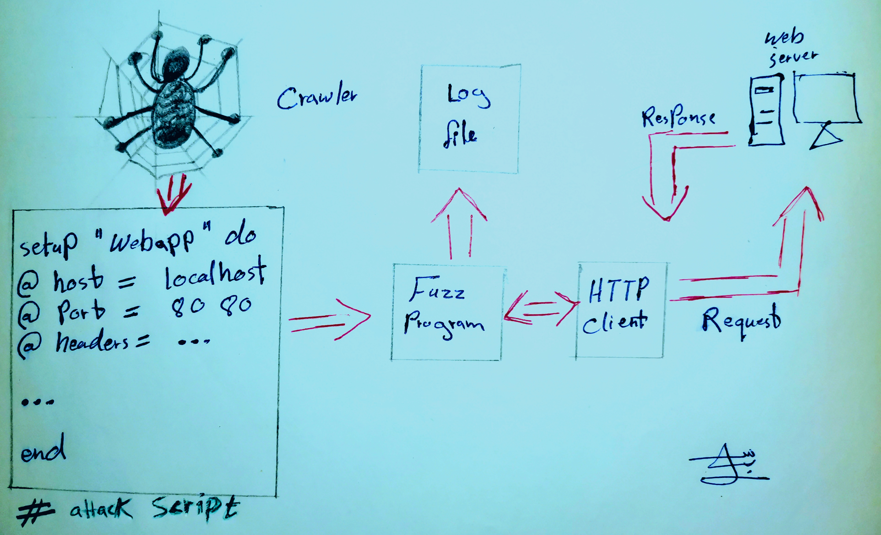
What is Fuzzing?
Fuzzing is technique/method in which a hacker use an automated software to provide invalid inputs to the input fields on a website using software’s called Fuzzers and then he looks for unexpected error and exceptions that the website give.
Setup “ Webapp” do
@host = localhost
@port = 8080
@headers = …
….
end
#attack script

Slide 3
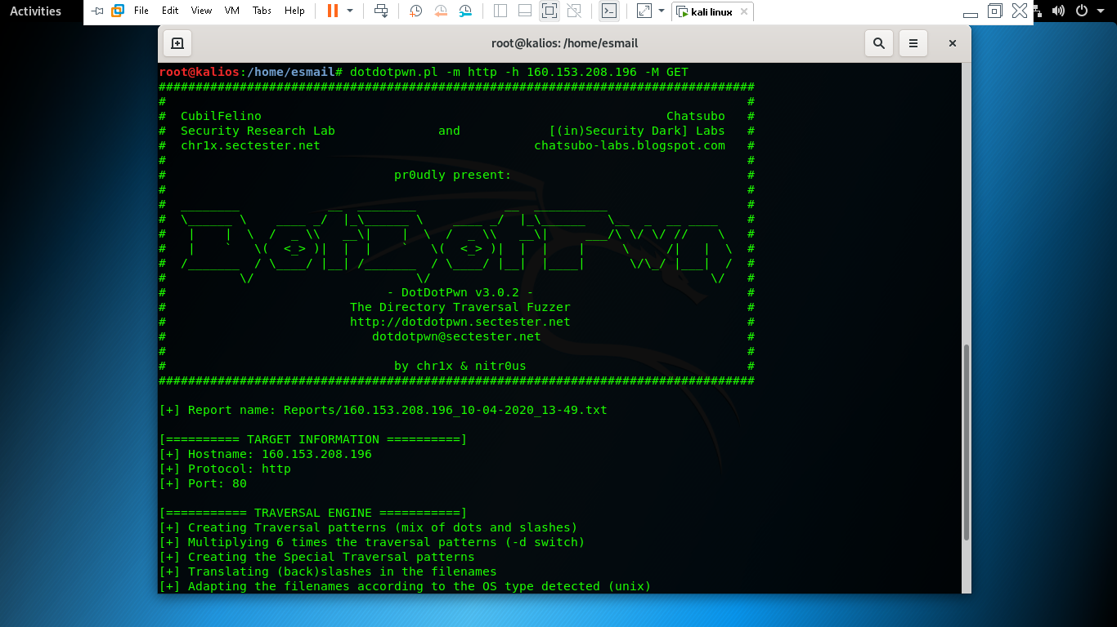
How it works ?
Fuzzer is a automated tool which automatically brute force the inputs from a dictonary file or a word-list which consist of harmful inputs. If these inputs are not correctly sanitized by the programmer/backend then this input can cause errors in the backend reflecting SQL injection and XSS Vulnerabilities .
DotDotpwn tool is used for fuzzing which comes preinstalled with Kali linux

Slide 4

Thanks for reading
Ismail Ahmed

